Slide 1
Obstacle detection model training based on Arduino
Final Project for EITP40
Group 6

Slide 2
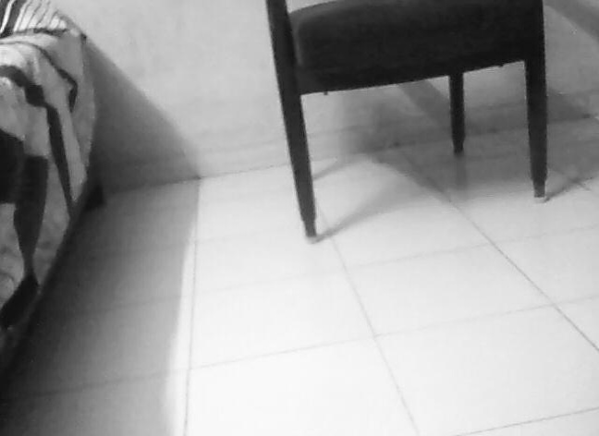
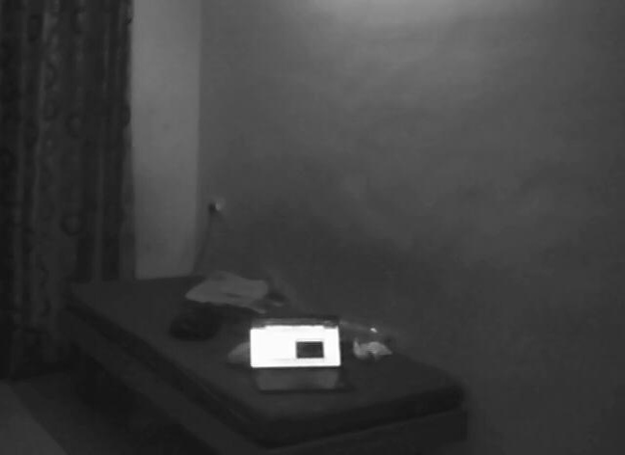
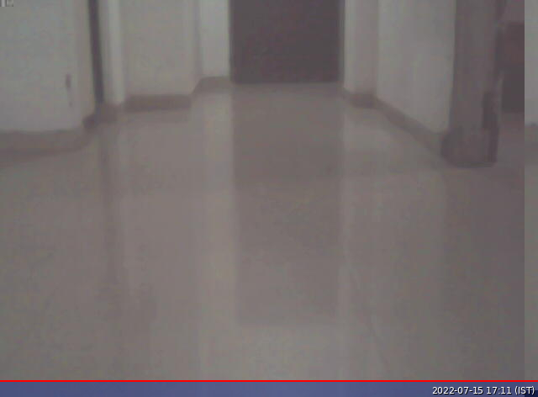
Image Preprocessing
Some images come from the Internet and we also added some photos we took ourselves to increase the richness of the dataset.
Considering the limitations of the model itself, we first need to use ‘resize’ to reduce the size of the image.
After labeling, normalize the data to accelerate convergence.
In order to reduce the complexity, using PCA to reduce the dimension of the data.

Slide 3
.npy
.h
Save the processed data set as data.h for on-board model training

Slide 4
ML Algorithm
Initialization
Forward Propagation
Backward Propagation

Slide 5
Training Parameter
Learning Rate:
Too high a value will cause the training process to oscillate or even fail to converge; Too small a value will result in slow convergence. We chose 0.05 after times of training
Epoch:
Since our data set is relatively small, we choose 50 epochs
Data Type:
Float occupies less memory and is faster to calculate than double. Since our resources are limited, we choose float
Nodes:
Considering the limited resources of Arduino itself and the small number of hidden nodes required for obstacle recognition, we choose 25 nodes.

Slide 6
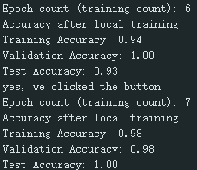
On board Training
After uploading the data set and training program, the expected training results were obtained. The test accuracy gradually increased to 0.93 with the number of training times.

Slide 7
Federal Learning (unfinished)
Local training
Pack the parameter
Send by BLE
Receive by PC
Parameter average
Send by PC
Receive from BLE
Unpack and update
Next Training

Slide 8
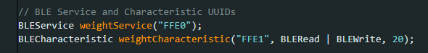
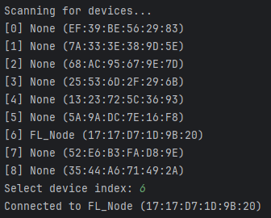
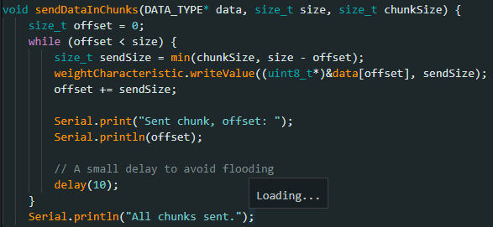
BLE
Using the Service and Characteristic UUID to find each other
Automatically identify all nearby connectable devices and select the ideal device model for Bluetooth pairing
Due to BLE limitations, the content to be sent is in chunks of length 20

Slide 9

But in the end, due to time constraints, we were unable to solve problems such as BLE instability and synchronization issue, which resulted in the inability to achieve the desired federated learning.

Slide 10
End slide. Image and logotype.
Thanks!

